Slide 1


Safe practice for forestry
and harvesting operations
Part five: Quiz

Slide 2
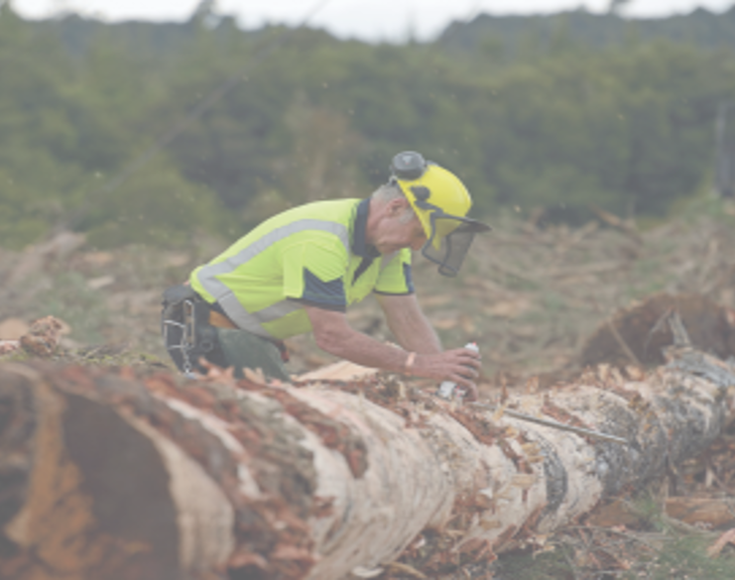
WorkSafe has new guidance for forestry businesses and workers: the Approved Code of Practice for Forestry and Harvesting Operations (ACOP) and the Good Practice Guidelines for Managing a Safe and Healthy Small Forest Harvest (GPG).
It’s aimed at helping businesses understand their health and safety obligations, but it’s good for everyone.
This short, simple quiz can help you practice and test your knowledge about the ACOP.

Slide 3
Which groups collaborated to develop the ACOP (2025) over the last 2 years?
Choose all that apply
a. | Kaimahi/workers | b. | FISC FOA Safe tree FICA
c. | WorkSafe inspectors and guidance teams | d. | Ministry of Business, Innovation and Employment (MBIE)

Slide 4
Truck drivers are in a designated safe area when they are…
Choose all that apply
a. | Inside the cab of the truck. | b. | Outside the cab, at least six metres from the front of the cab and always visible to the loader operator.
c. | Watching from the side of the truck, six metres from the cab and always visible to the loader operator. | d. | In a crew shelter or smoko room.

Slide 5
Which of these areas is in the ACOP 2025 ?
Choose all that apply
a. | Winch-assisted harvesting | b. | Work-related health
c. | Helicopter logging | d. | Establishment and silviculture

Slide 6
What does the ACOP 2025 replace ?
Choose all that apply
a. | Approved Code of Practice for Safety and Health in Forestry Operations (2012) | b. | Role and responsibilities of principals and contractors ACOP (2016)
c. | 29 Technical bulletins | d. | GPGs (3) and Fact sheets (2) Safe manual tree felling Guidelines for the provision of facilities and general safety and health in forestry work Safe retreat positions in breaking-out Machine-assisted felling using a grapple Winch-assisted harvesting on steep slopes

Slide 7
How can a business show it is engaging with its workers on health and safety?
Choose all that apply
a. | Tell workers when a decision is made for them. | b. | Ask workers for their views and listen to their ideas.
c. | Have a quick chat with managers about safety. | d. | Ignore workers’ concerns, unless there is an accident.

Slide 8
Why is it important for workers/kaimahi to speak up about risks and concerns?
Choose all that apply
a. | It helps improve safety for everyone | b. | Managers need something to do
c. | It makes meetings longer | d. | It is a legal requirement that workers have the right to speak up

Slide 9
What is a good first step for people working away from the main crew/alone?
Choose all that apply
a. | Make sure they have a mobile phone and check in at the end of the day. | b. | Make sure they have a first-aid kit and have had first-aid training.
c. | Provide man-down alarms. | d. | Provide emergency contacts and GPS locations before they head out.

Slide 10
When it comes to emergency exits in vehicles, you need to make sure that…
Choose all that apply
a. | There are two emergency entry/exit points. | b. | All emergency exits can be opened or activated both internally and externally.
c. | If a machine has latches on the doors, the latches function properly. | d. | There is a way of getting operators out of machines if all the emergency exits are blocked or cannot open.

Slide 11
Why is it important to manage fatigue?
Choose all that apply
a. | It is hard to recognise when someone is tired. | b. | Fatigue may contribute to injuries and accidents.
c. | Fatigue can lead to poor decision making. | d. | Fatigue is a condition we have to manage in our work.

Slide 12
Who has a role in creating a
safe and healthy workplace?
Choose all that apply
a. | The forestry community and whānau | b. | The forest owners
c. | Contractors and principals | d. | WorkSafe inspectors, when they are here

Slide 13
We want everyone to come home from work healthy and safe.
Check out the Forestry ACOP learning modules for more information: Forestry | WorkSafe

