Slide 1
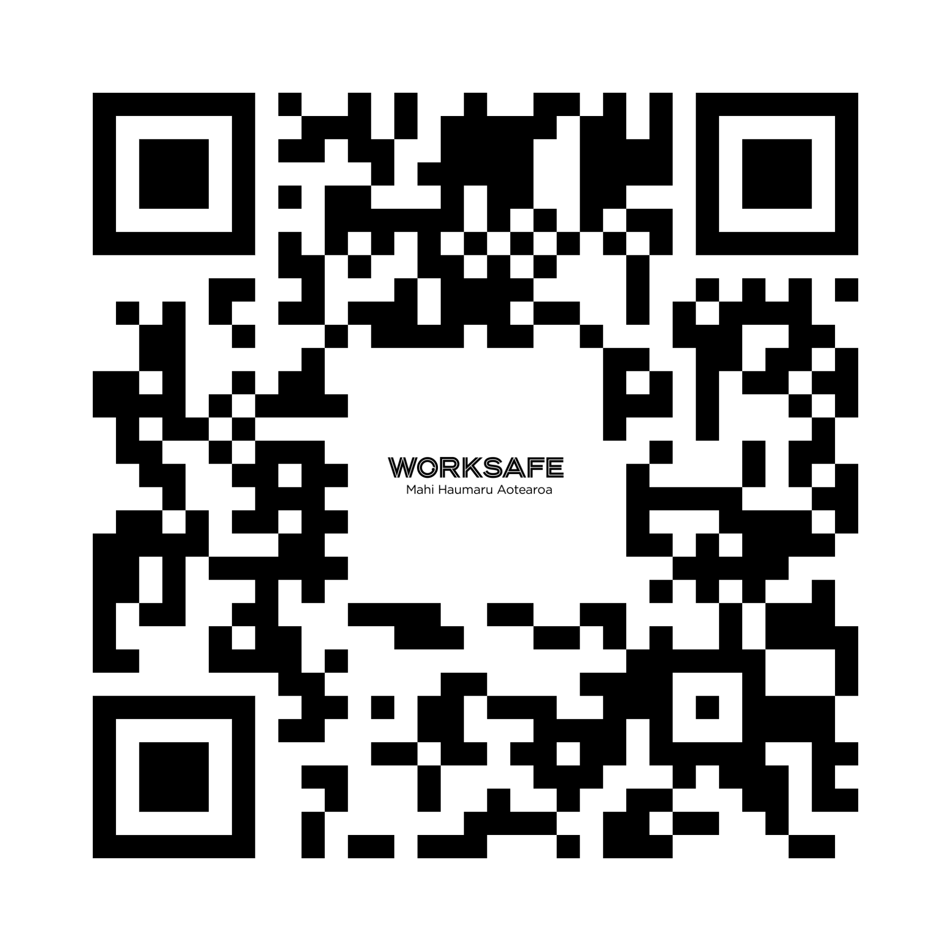

Safe practice for forestry
and harvesting operations
Part three: Overlapping duties example

Slide 2
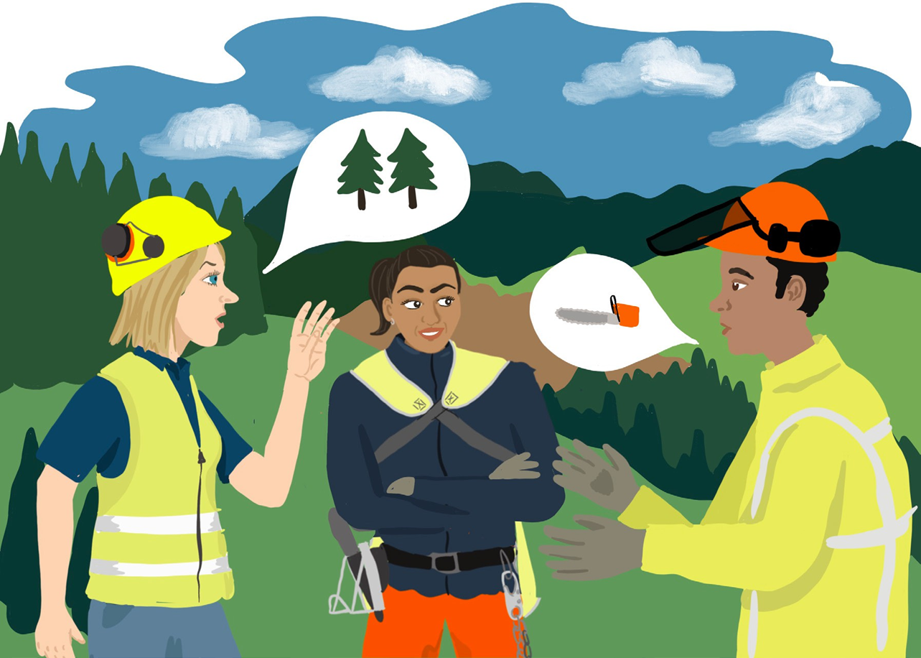
Overlapping duties
When a PCBU works in a contracting chain, they work with other PCBUs.
This means they are likely to share health and safety responsibilities under the Health and Safety at Work Act.
They all have a duty for keeping workers safe.
This is known as overlapping duties.
Read on for example about how this works.

Slide 3
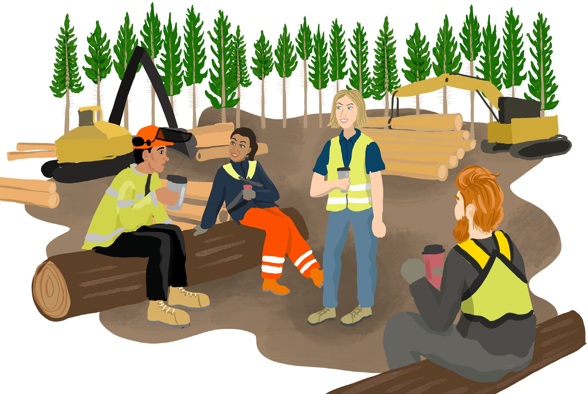
Overlapping duties – a really short story

Slide 4
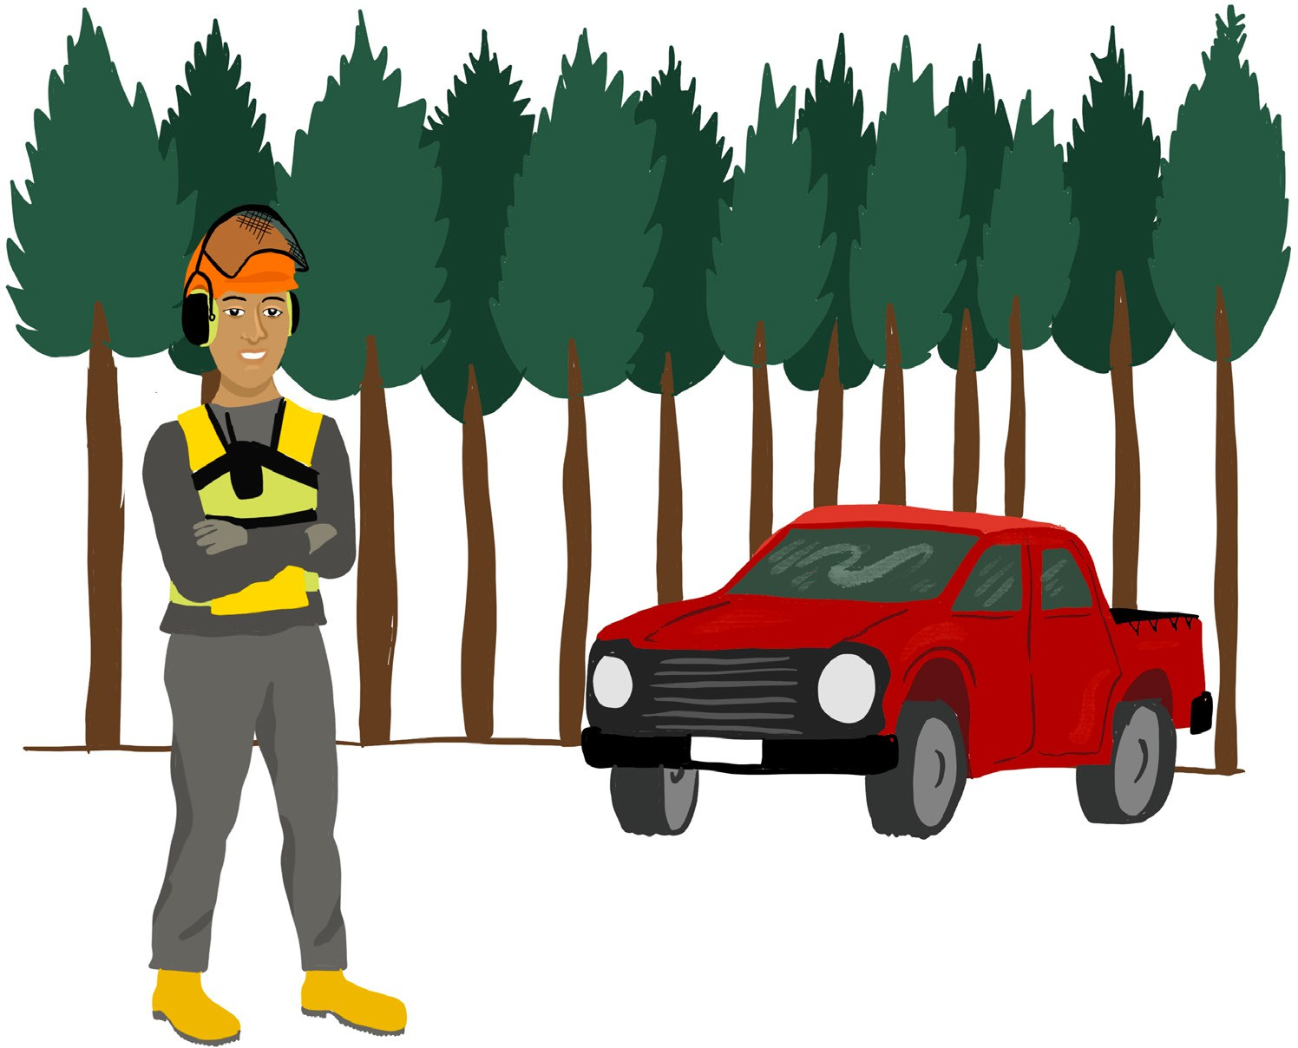
Businesses and people get better at safety when the responsibility is shared across all the businesses involved.

Slide 5
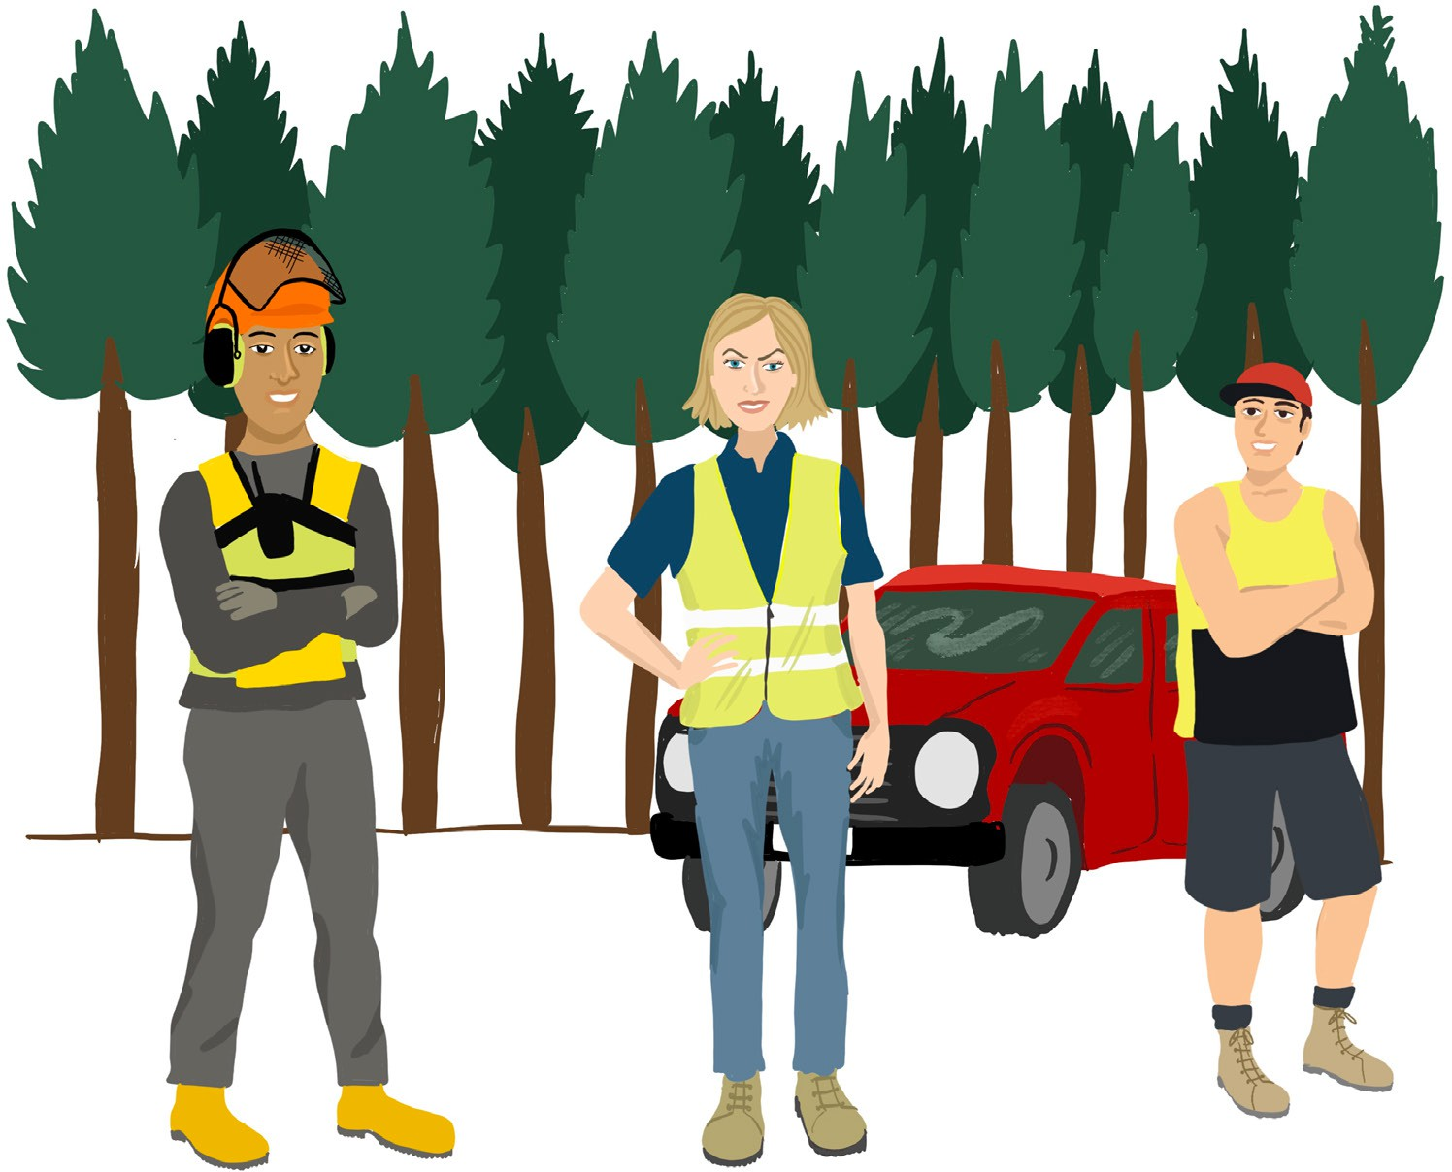
You must work with other PCBUs who are working in the forest.
You must work with others who are affected by your work in the forest.

Slide 6
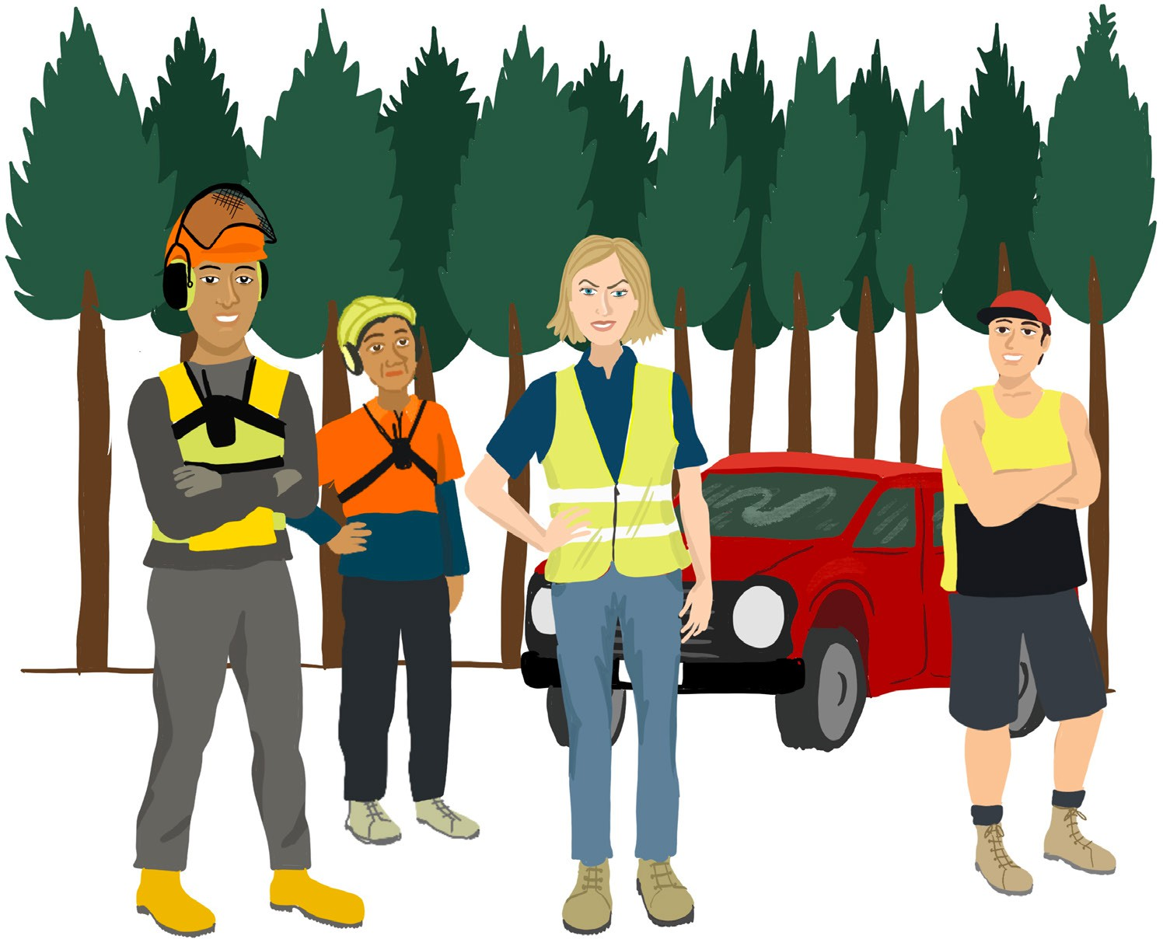
Think about the people who need to work together.

Slide 7
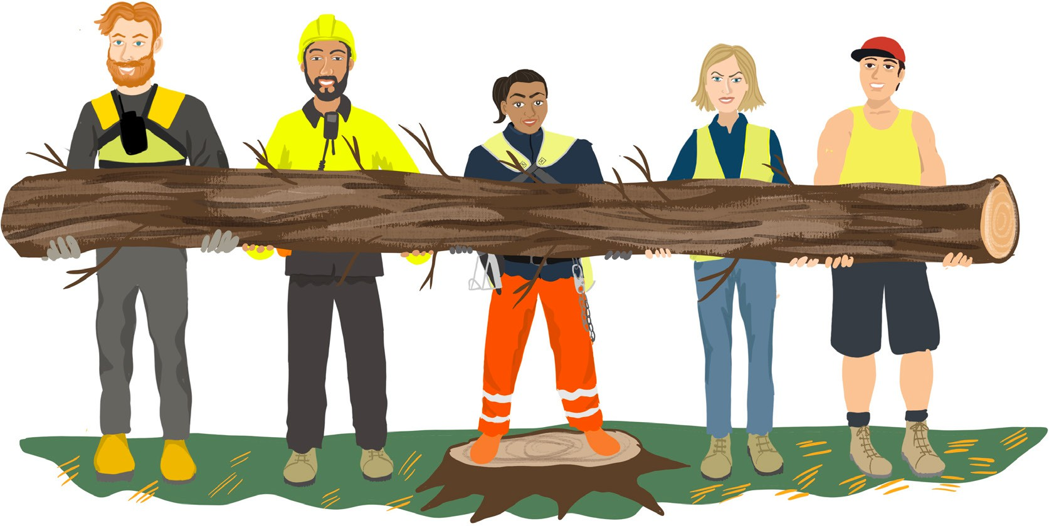
Overlapping duties means sharing plans about:
what you are doing
when you are going to undertake your work
risks the work will create
who has influence and control over the work and the workplace.

Slide 8
Overlapping duties also means sharing plans about:
the harvest plan
workers who are involved in certain activities
the activities of each PCBU
the plant and equipment each will use…
and making shared plans to manage those risks.

Slide 9
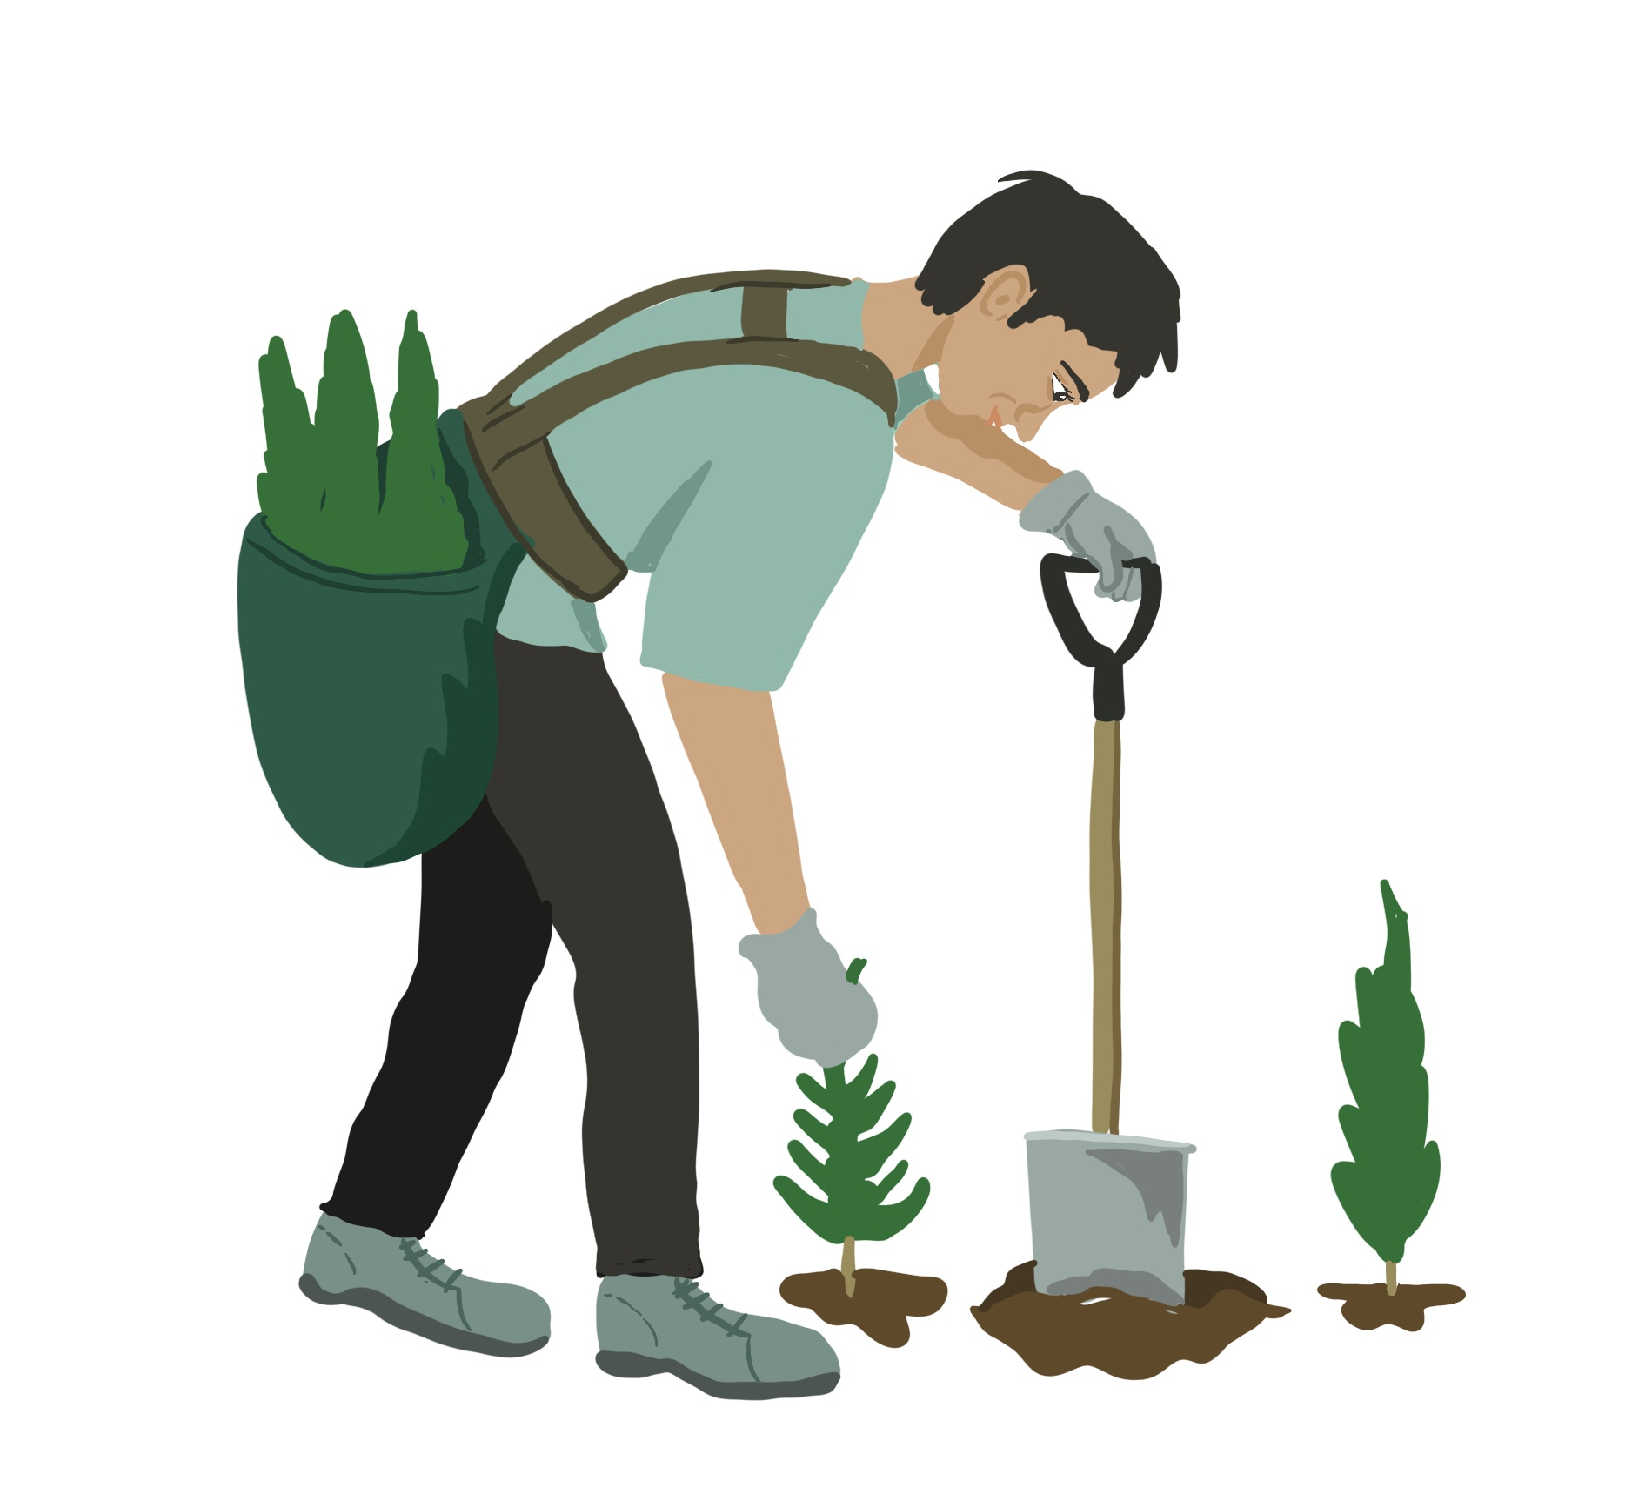
When an individual person representing a business comes onto the site, they have overlapping duties.
The business running the forest work has overlapping duties with the individual business.

Slide 10
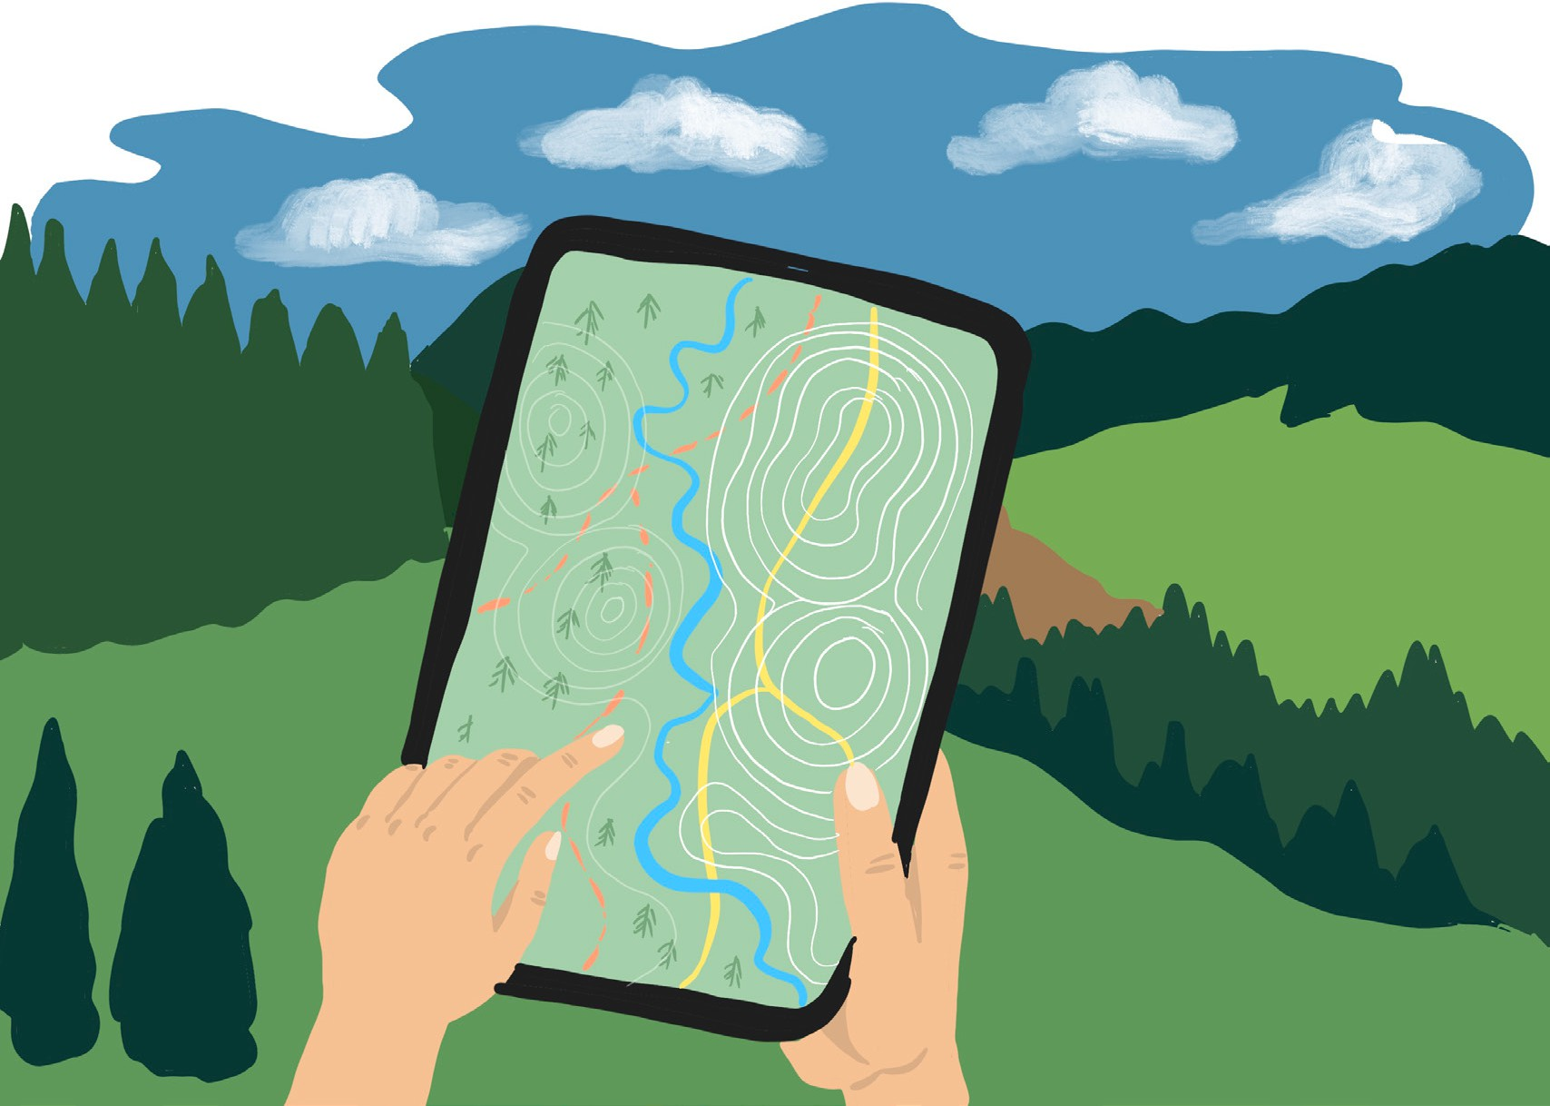
Each PCBU must manage risks – for all the work they control and share with other PCBUs.
PCBUs must control the risks and not do anything that compromises health and safety.

Slide 11

This means discussing health and safety.
This means complying with reasonable requests from other PCBU’s, so they can meet their duties.

Slide 12
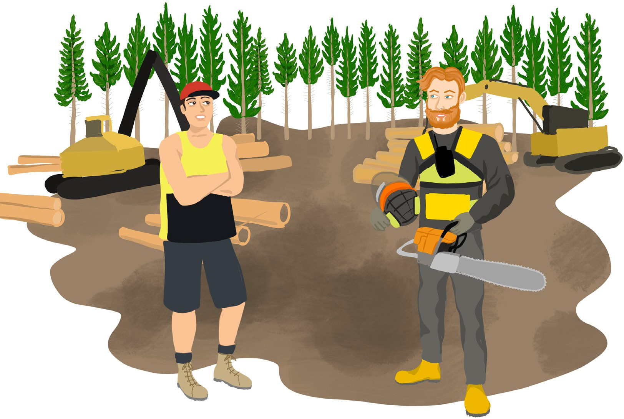
What if one of the duty holders does not discuss and manage overlapping duties?
If there is a disagreement between businesses, you do not need to accept poor health and safety performance.

Slide 13
When you share and
discuss overlapping duties:
each PCBU understands
how the risks are being managed
it helps avoid a situation
where a risk is not being managed
because one
PCBU thinks
it is being managed by another PCBU.

Slide 14
Remember
Stand back from what you are doing, look at what is going on around you, and think about who is going to do what.
Talk to the other PCBUs involved. Agree on how risks are going to be managed:
talk about what is going on – and what will be going on in the future – and who is going to be doing it
discuss the level of control that each PCBU has over the activity
agree on who will manage what and how it will be managed
agree on shared facilities, if applicable
talk about how they are going to monitor and check on things.

Slide 15
We want everyone to come home from work healthy and safe.
Check out the Forestry ACOP learning modules for more information: Forestry | WorkSafe

