Slide 1


Safe practice for forestry
and harvesting operations
Part two: Summary of changes

Slide 2
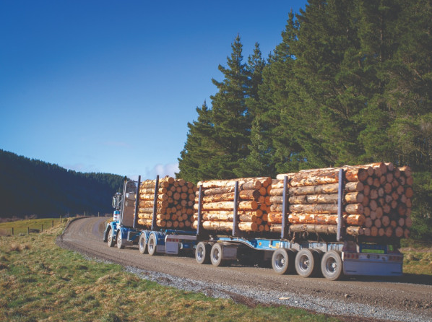
WorkSafe has new guidance for forestry businesses and workers: the Approved Code of Practice for Forestry and Harvesting Operations (ACOP) and the Good Practice Guidelines for Managing a Safe and Healthy Small Forest Harvest (GPG).
The guidance is aimed at businesses, as it sets out what they need to do under health and safety law – but it’s good for everyone.
The 2025 version of the ACOP includes additional guidance with a stronger focus on what workers need to keep safe on site.
Read on for a summary of the technical changes to the guidance.

Slide 3
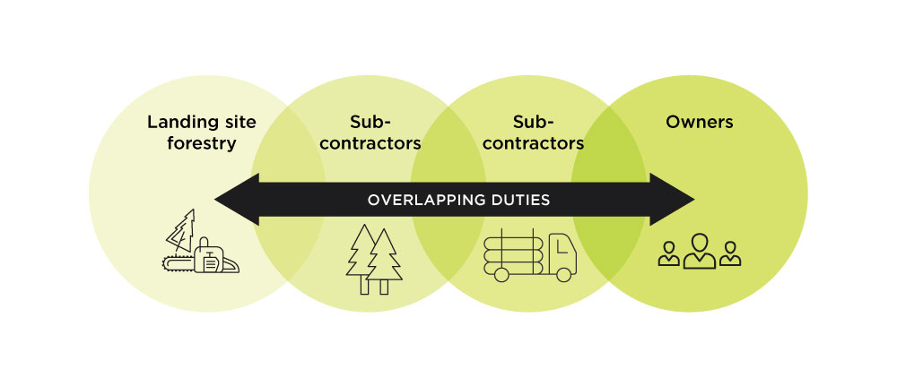
Part A: Managing health and safety through the contracting chain
Health and Safety at Work Act
Important points for principals and contractors
There is new information on:
the Health and Safety at Work Act (HSWA) including identifying and managing risks. The previous ACOP was written before the HSWA.
the contracting chain and overlapping duties – the different roles and how they can work together.
Notes:
3

Slide 4
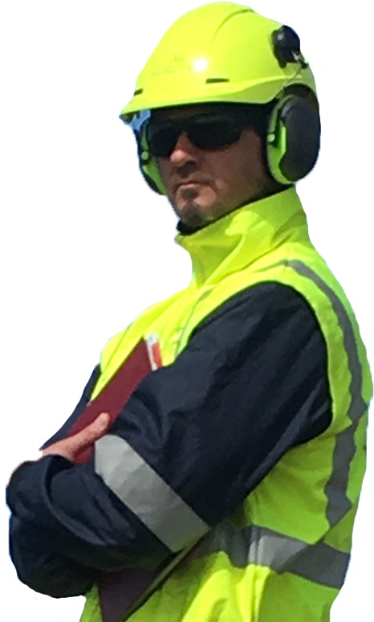
Part A: Managing health and safety through the contracting chain
Managing work-related health
This section covers all aspects of work-related health. More information has been added about:
fatigue (extreme physical or mental tiredness)
noise
working in extreme temperatures
risks to mental health
exposure to excessive vibration from tools or machinery.
Notes:
4

Slide 5
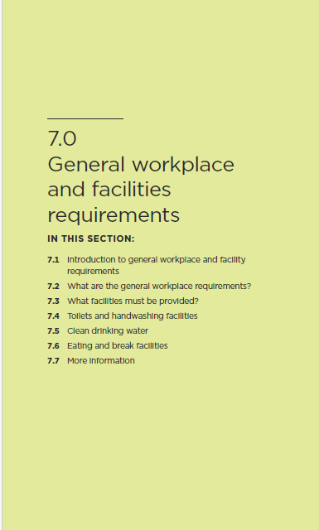
Part B: General requirements
This section includes guidance on general requirements for health and safety, including:
the facilities that must be available to workers, such as toilets, clean drinking water, and somewhere to eat and rest
first aid kits
emergency plans so workers know what to do in an emergency
Personal Protective Equipment (PPE)
training and supervision for workers
communication (how workers can share information with each other, including if an incident occurs)
risks from workers using alcohol and drugs.
Notes:
5

Slide 6
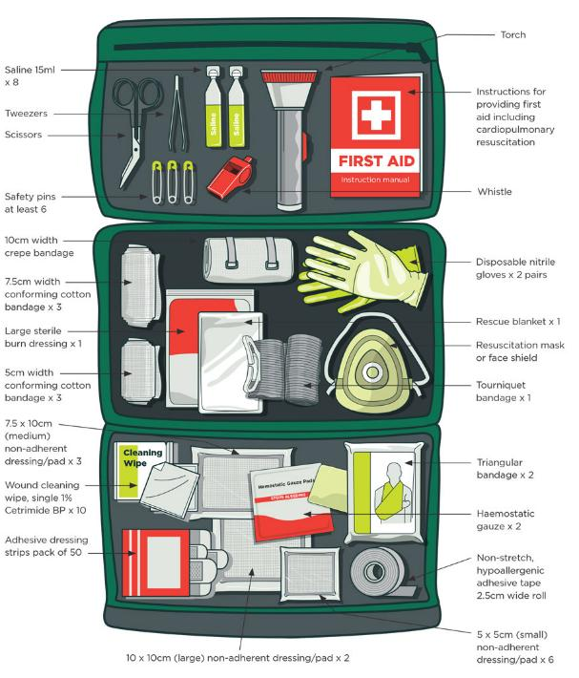
Part B: General requirements
First-aid
The illustration of the first aid kit has been updated. It’s now more specific about what items need to be included, such as:
tourniquet bandages
haemostatic gauze.
Notes:
6

Slide 7
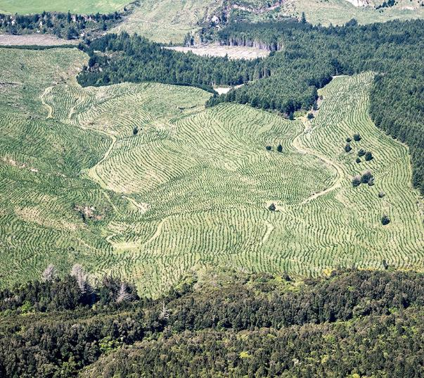
Part B: General requirements
Fires and burn-offs
New information about managing the risk from fires has been added to the section on workplace emergency plans.
The section on controlled fires and burn - offs has been removed.
Notes:
7

Slide 8
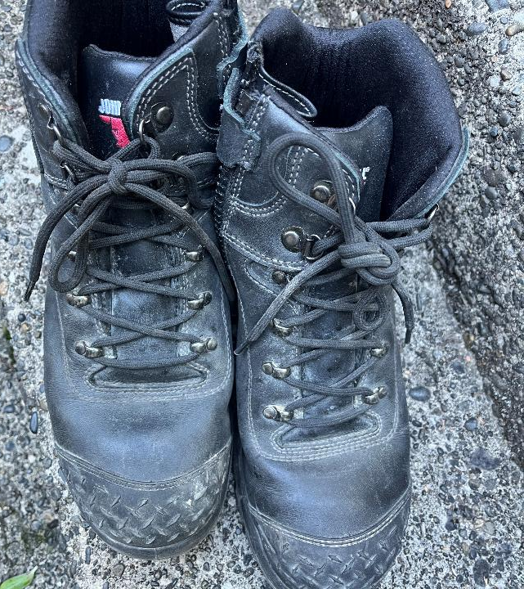
Part B: General requirements
Personal Protective Equipment (PPE)
PPE is now included in this part of the general principles, including:
  how it is used
  who provides it.
Specific PPE is included in the relevant sections.
Notes:
8

Slide 9
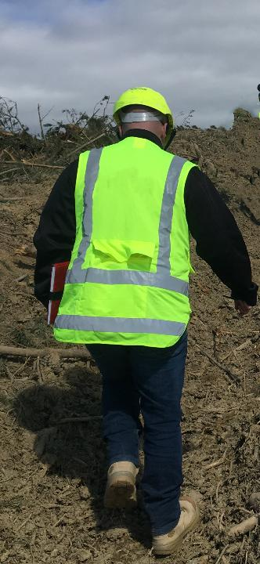
Part B: General requirements
Training
There’s new information on
training
information for workers
instruction
supervision.
Notes:
9

Slide 10


Part B: General requirements
Communication
Workers must be equipped with a good communication system that is:
reliable
effective
Do not rely on a worker’s mobile phone.
Notes:
10

Slide 11

Part C: (new section)
Site access and preparation of log landings
All construction standards refer to the New Zealand Forest Road Engineering manual.
There is specific guidance on control measures for traffic entering and exiting the forest, such as:
having signage at the entrance to show the correct radio channel
turning lights on
easily accessible road markers at appropriate intervals – so users can call their position on the roads.
Notes:
11

Slide 12

Part D: Establishment and silviculture
The 2025 ACOP now says, under 17.1.7 Safe practice with brush cutters:
‘Make sure that all safety features are fitted and in working order’.
Notes:
12

Slide 13
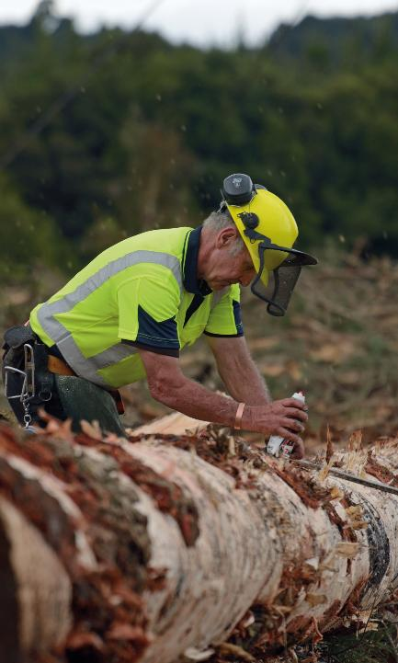
Part D: Establishment and silviculture
Manual handling practices
This section describes how to manage risks relating to sprains and strains.
The guidance describes pruning from a ladder.
The regulations require that where a worker could fall more than 3 metres, the employers must so far as reasonably practicable, provide a means to
prevent falling.

Slide 14
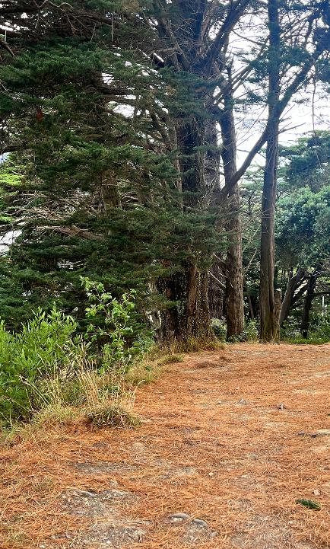
Part E: Mobile plant and harvesting
This section covers:
mobile plant
mechanised felling
winch-assisted harvesting
manual felling including machine-assisted felling
cable logging including manual breaking out.
Notes:
14

Slide 15
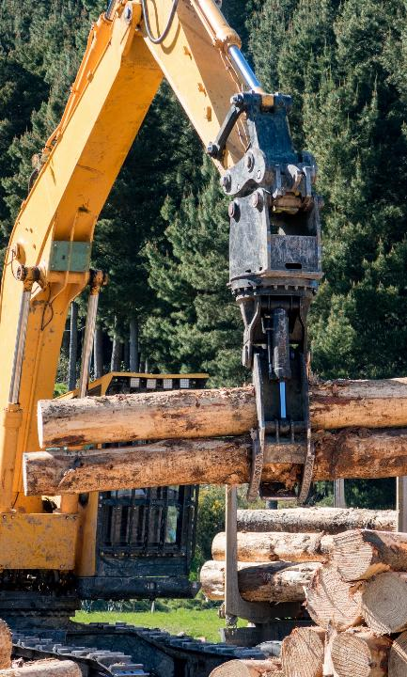
Part E: Mobile plant
There is updated information on protective structures
on mobile plant.
It is recommended that the standard for polycarbonate windshields is 32mm for the front shield of a harvester
or processor.
Notes:
15

Slide 16
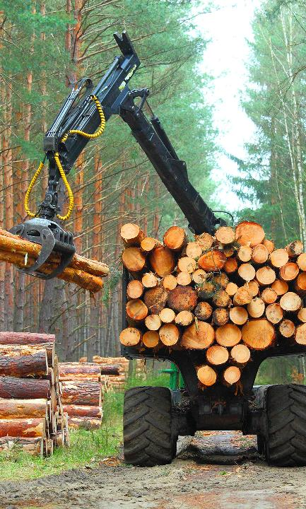
Part E: Mobile plant and harvesting
There is a strengthened section on emergency exits.
There must be at least two emergency exits:
able to be manually opened
not blocked or hindered by protective structures.
There must be tools in the cab to activate emergency exits.
Training for operators should include checking:
knowledge and use of emergency exits
capability to use emergency exits.
Notes:
16

Slide 17
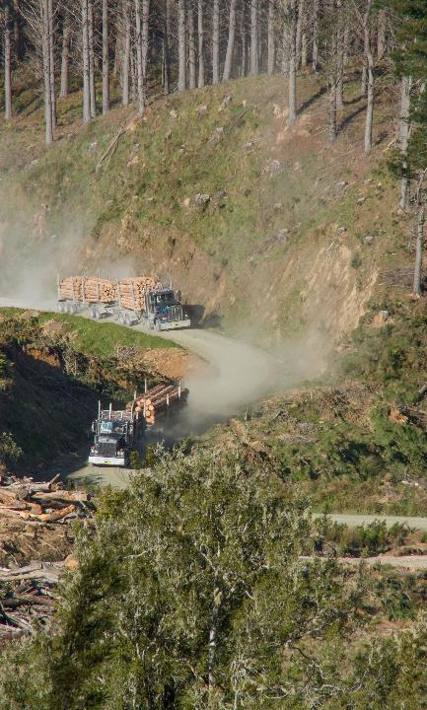
Part E: Mobile plant
There has to be a process to manage the risk of water entering the cab, if the plant is operating near water.
This includes the suitability of emergency exits able to be manually opened.
Consider a supplementary breathing system.
Notes:
17

Slide 18
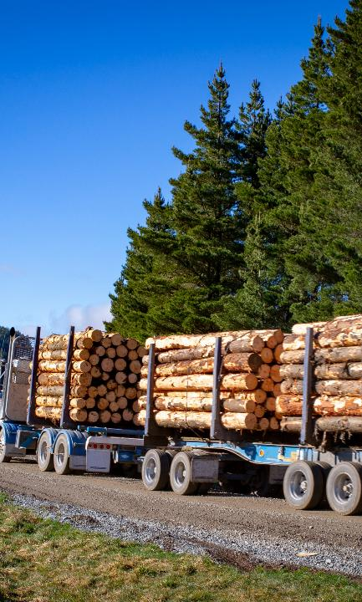
Part E: Mobile plant
Plant should have a fire suppression system in the
engine bay.
There is a new section on safe procedures for maintaining and repairing mobile plant, including an example Statement of Practice (SOP) for managing risks while repairing.
Notes:
18

Slide 19
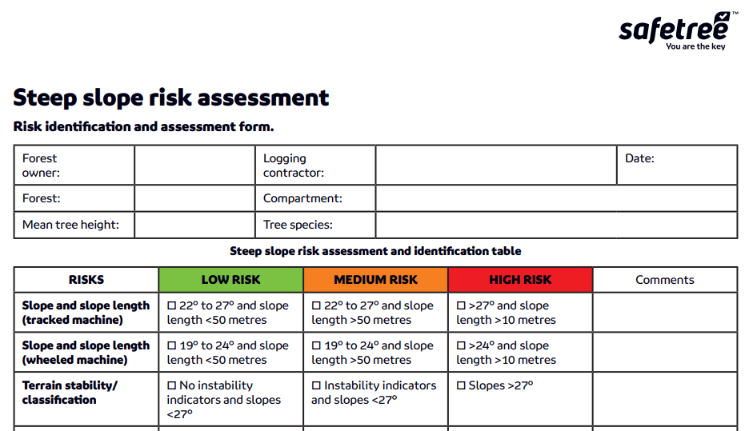
Part E: Mechanised felling
There is reinforced guidance on machine-worker separation distances.
There is guidance on:
chain-shot separation distances
determining a machine’s slope limits.
It is recommended that SafeTree’s slope risk assessment tool is used.
Notes:
19

Slide 20

Part E: Mechanised felling
PCBUs operating plant using a winch-assist anchoring system need OEM or CPEng. Certification to determine that the winch-assist steep slope harvesting system is:
designed
tested
demonstrated to be safe.
All winch-assist and mobile tail-holds should a have a movement alarm, to warn if the anchor moves, which immediately alerts the operator.

Slide 21
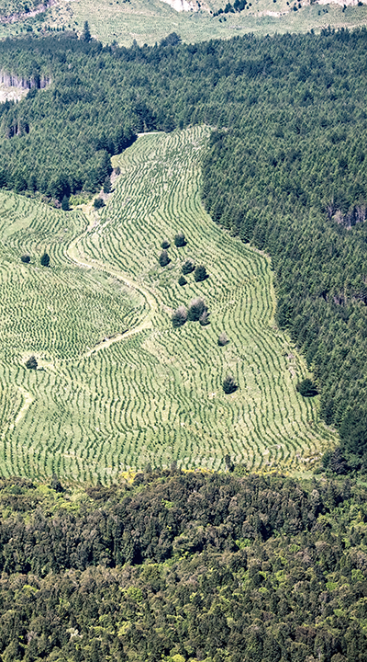
Part E: Manual tree felling
There is much more detailed guidance on manual tree felling.
All dangerous and wind-affected trees should be felled by machine where practicable.
Under the section on PPE, it includes as industry best-practice that workers’ high-vis helmets meet recognised industry standards.

Slide 22
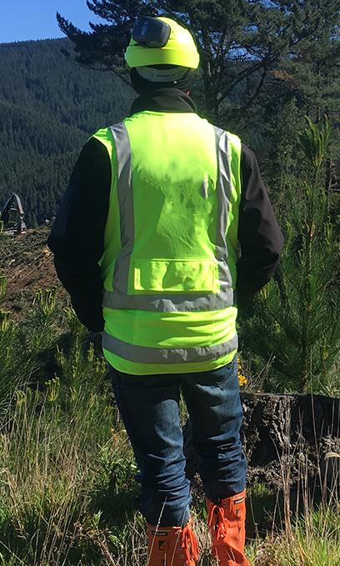
Part E: Manual tree felling
Workers should have a lone worker
(‘man down’) device or radio equivalent.
It is industry best practice that all fallers and observers carry RT.
All fallers and observers should have RT-enabled hearing protection.
An observer should be available on site and used when a faller is uncertain or in a high-risk situation.

Slide 23
Part E: Manual tree felling
Observers should be skilled in recognising and managing risk.
This differs from the previous requirement of having a specific qualification.
Managing the risk of felling dead trees
The guidance is that dead trees should be identified before the faller begins working
the area.
Assess the risk and manage the risk.

Slide 24
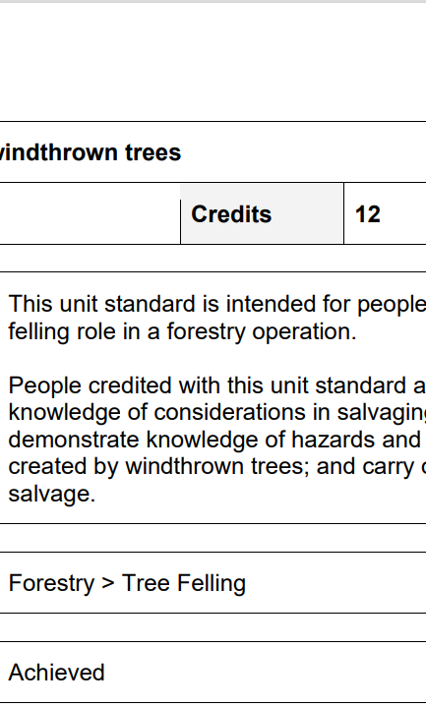
Part E: Manual tree felling
Machine-felling should always be considered as the first option for felling wind-damaged trees.
If windthrow or wind-damaged trees are to be manually felled, the only people that should do this will have:
appropriate windthrow skills or unit standard qualification
the experience and competence to fell windthrow.
There is reinforced guidance on machine-assisted felling, with clear differences on the controls between the plant operator and the manual feller.

Slide 25
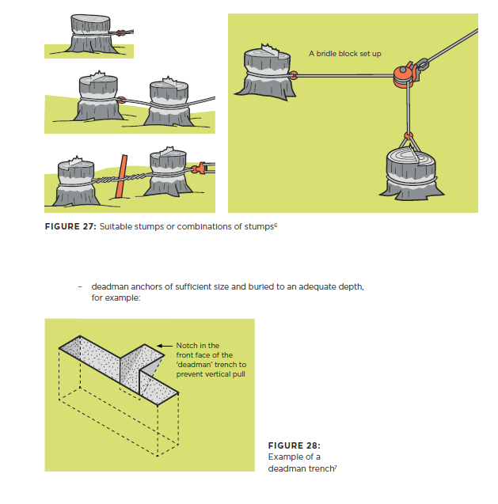
Part E: Manual tree felling
Cable logging
This section has been reinforced and includes more technical detail.
All yarders and yarder towers should be:
inspected every year by a CBIP*-certified Yarder Engineering Safety Inspector
tagged as certified.
* Certified Board for Inspection Personnel

Slide 26
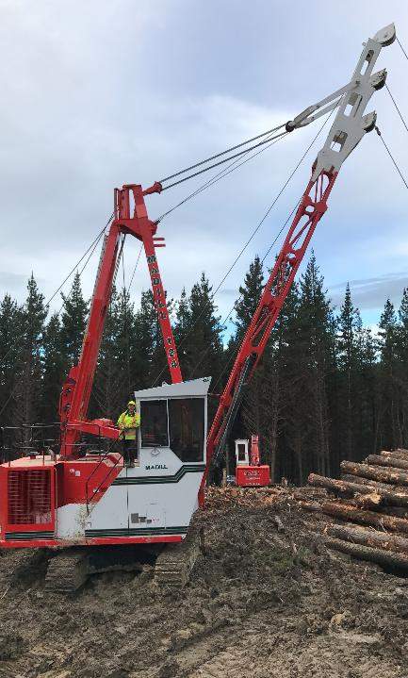
Part E: Manual tree felling
The Yarder should be inspected by a CPEng. with knowledge of the tower – if there is a tower tip-over or
if a part is damaged.
Structural changes to towers should only be made under the direction of the manufacturer or a CPEng.

Slide 27
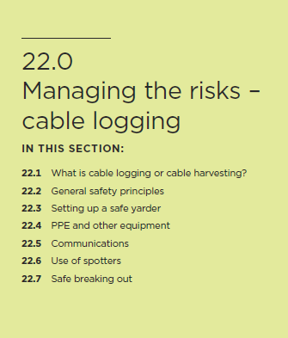
Part E: Manual tree felling
Manual breaking-out
The breaking-out section has been reinforced.
The head breaker-out and spotter should have hands- free RT for communicating with each other and the hauler operator.
The risks of retrieving a straw-line need to be managed, with:
procedures for clearing an obstruction
agreed practices for the release of tension on lines, to avoid recoil.

Slide 28

Part E: Manual tree felling
Manual breaking out (continued)
Managing stems on the landing.
PCBUs must eliminate the risk from unhooking stems so far as is reasonably practicable(such as by electronic chokers).
The poleman is one of the most hazardous jobs on a landing site and anything that can be done to eliminate risks to them, should be done.

Slide 29
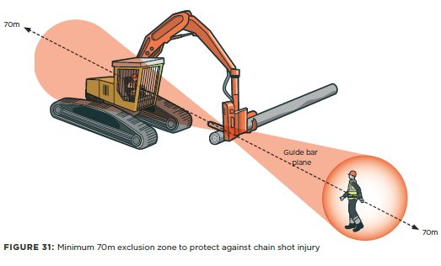
Part F: Work on landings and loading/unloading trucks
This section has been reinforced and now includes information on:
Establishing exclusion zones and safe work areas. If a mechanised processor is operating:
make sure that there is a 70m exclusion zone to protect against chain shot injury.
Make sure the log stacks:
are no higher than the safe capacity of the log handling equipment
are kept on level ground and angled to ensure stability.

Slide 30
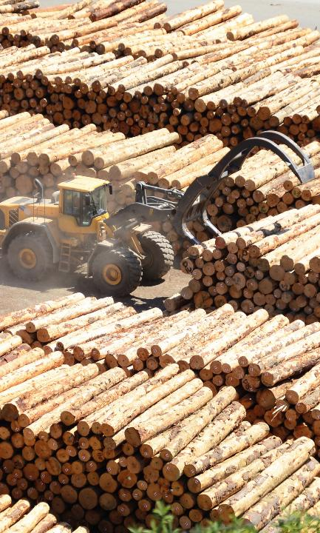
Part F: Work on landings and
loading/unloading trucks
The truck driver and loader operator need to be in constant communication.
If communication is lost at any time, the loading process should stop until communication resumes.
The guidance refers to the
Log Transport Safety Council Manual
for detailed guidance on signals and load safety.

Slide 31
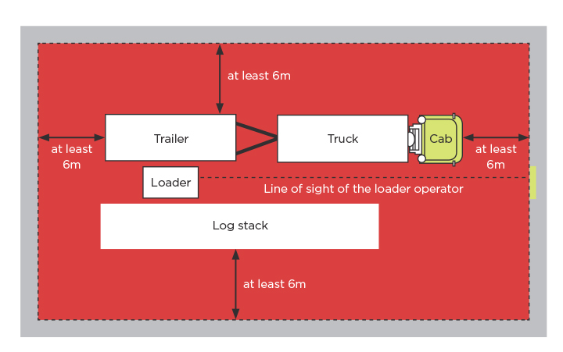
Part F: Work on landings and loading/unloading trucks
This section has been reinforced.
The illustration of the safe loading zone has been changed, to make sure that any safe areas for the driver are at least 6 metres from the front of the cab.

Slide 32
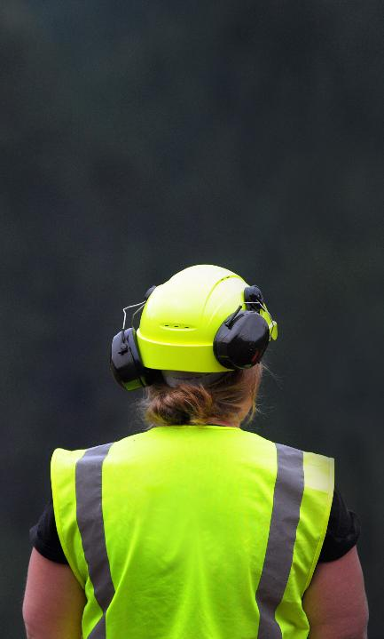
Part F: Work on landings and
loading/unloading trucks
When loading in the dark, anyone working on the landing should be wearing:
day-night high-vis vests
helmets.
The loading area should be adequately lit, with additional lighting provided by, for example:
the loading lights of the truck
extra lighting on the loader (more than the driving lights)
lighting systems on the log landing.

Slide 33
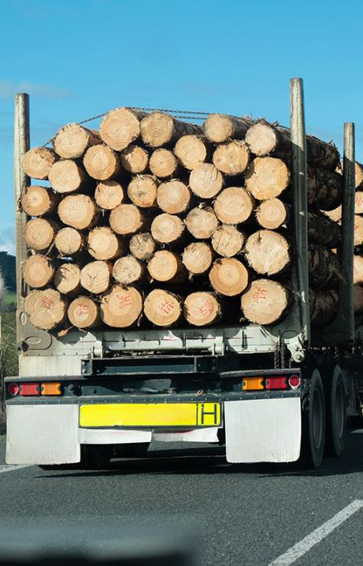
Part F: Work on landings and loading and unloading trucks
All loads need to be restrained safely and in accordance with the Log Safety Council Manual.
Drivers can move up 100 metres to a safe area before securing the load.

Slide 34
Part F: Working on landings
Wood residual and biomass processing
There is a new section on managing the risks of wood residual and biomass processing.
Slash on landing is covered with The New Zealand Forest Service’s Slash risk-management handbook.

Slide 35
We want everyone to come home from work healthy and safe.
Check out the Forestry ACOP learning modules for more information: Forestry | WorkSafe

