Slide 1


Safe practice for forestry
and harvesting operations
Part one: About the ACOP 2025

Slide 2

Updated guidance for forestry
WorkSafe has new guidance for forestry businesses and workers: the Approved Code of Practice for Forestry and Harvesting Operations (ACOP) and the Good Practice Guidelines for Managing a Safe and Healthy Small Forest Harvest (GPG).
The guidance is now easier to read, with words that WorkSafe and industry have agreed on.
It sets out how forestry and harvesting operations can be done safely. Businesses and workers can follow it to keep people safe.
It combines legal requirements, technical information and good practice examples of everyday forestry work. New sections have been added.
It’s been updated to match the Health and Safety at Work Act 2015 (HSWA).

Slide 3


The updated ACOP came into effect on 25 August 2025
Forest Operations 2012
Roles and Responsibilities of Principals and Contractors 2014
– revoked and removed
Old ACOPs will no longer have legal status
Technical bulletins
have been
incorporated
Notes:
3

Slide 4
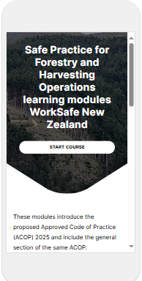
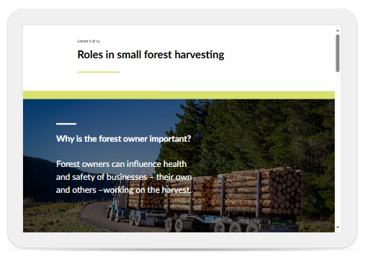
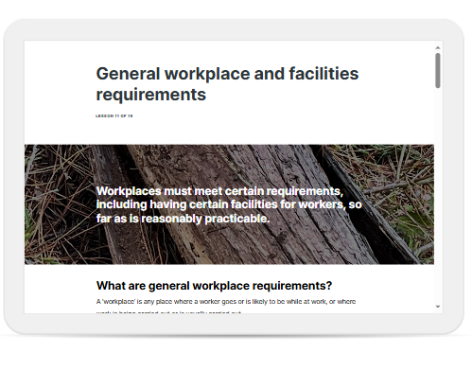
WorkSafe has made online learning modules to help businesses and workers understand the guidance.
You can find them on our website
Notes:
4

Slide 5
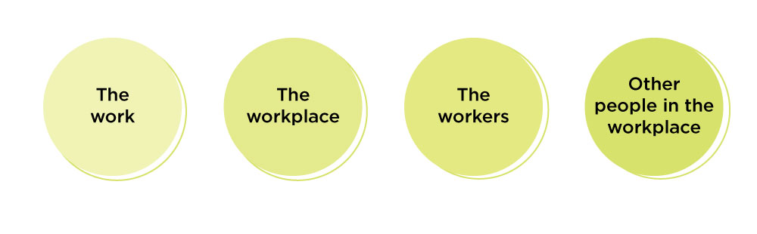
The updated guidance helps improve health and safety for everyone.
Notes:
5

Slide 6
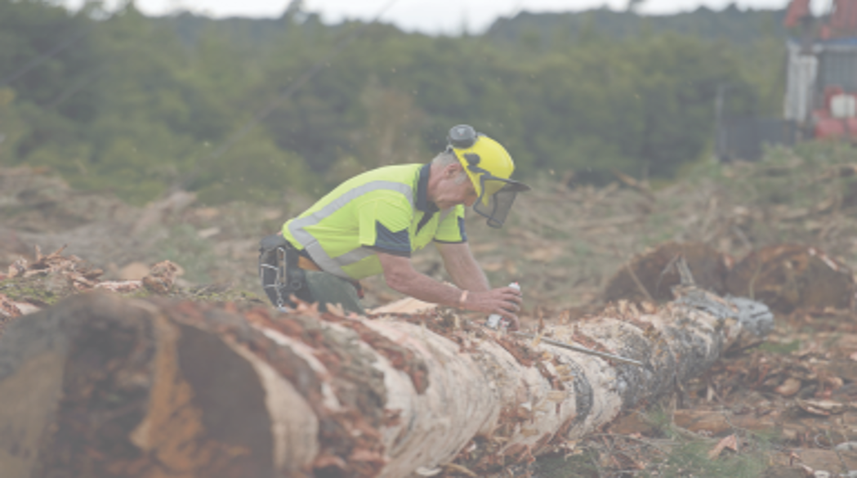
The guidance uses ‘must’ to refer to things that are legal requirements under health and safety law.
Where ‘must’ isn’t used, it’s a recommended action, because it’s good practice.
This helps businesses and workers better understand what’s needed, and how to keep people safe.

Slide 7
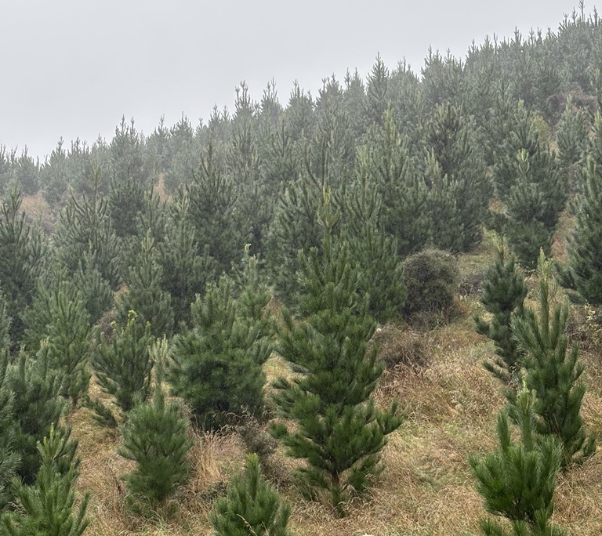
What's been added to the ACOP?
New examples of everyday forestry work
Updated technical health and safety information
There are new sections on:
work-related health
establishment and silviculture
winch assisted harvesting.
Notes:
7

Slide 8
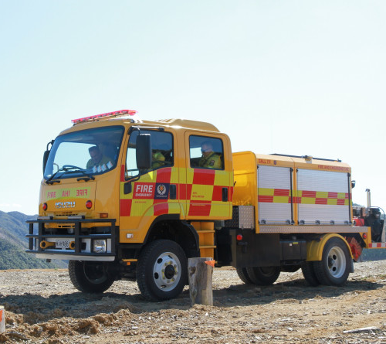
What's been removed from the ACOP?
There are no sections on:
controlled fires burn-offs (considered best managed by Fire and Emergency New Zealand)
and
helicopter logging.
https://commons.wikimedia.org/w/index.php?curid=128322817
Notes:
8

Slide 9
We want everyone to come home from work healthy and safe.
Check out the Forestry ACOP learning modules for more information: Forestry | WorkSafe

