Slide 1

SPEAK UP
  STEP UP
    How to build a strong health
    and safety culture

Slide 2



What does this workshop cover?
Learn
Improve
Keep
going
  What a strong health and safety culture can be
  Make your health and safety culture stronger
  Keep your health and safety culture strong

Slide 3
Why is this important?
No one should be harmed or killed at work.

Slide 4



  Did you know that every year:
50–60
people are killed
at work
400–500
people are hospitalised with a serious work-related injury
750–900
people die because of work-related ill health (estimated)

Slide 5

Why is this important?
  In New Zealand, the workplaces with the most harm and risk are in forestry, agriculture, construction and manufacturing.
  You can help your workmates get home safe by building a strong health and safety culture.

Slide 6
How?
Take time out with your team.

Slide 7

How?
  Find out how you and your workmates can help build a strong health and safety culture by:
    Reading and discussing the information in this workshop and on the WorkSafe website
    Watching the videos about how other people do it
    Completing the activities as a team
    Keep going — continue talking about your health and safety culture.

Slide 8
Worker Engagement, Participation and Representation
What is it,
and why is it important?

Slide 9
Businesses must involve their workers in health and safety – it’s the law.
  We call this worker engagement, participation and representation.
“Health and safety decisions are better when
the voice of workers is represented.”
“Work is safer when everyone engages with
– and participates in – health and safety.”

Slide 10



What does this mean?
Workers need to be involved with identifying risks, contributing to decisions, suggesting ideas, and asking questions.
Trust and good relationships are key. The more trust people have, the more likely they are to participate in health and safety.
Workers need ways to share their ideas, and businesses need ways to listen. This supports a strong health and safety culture.
What can you do to make sure this is happening at your work?

Slide 11

SPEAK UP

Slide 12

SPEAK UP
    Talk to each other about health and safety:
    Discuss the risks at work
    Share information about hazards and near misses
    Have your say on health and safety matters
    Ask questions
    If something could be done better – speak up

Slide 13
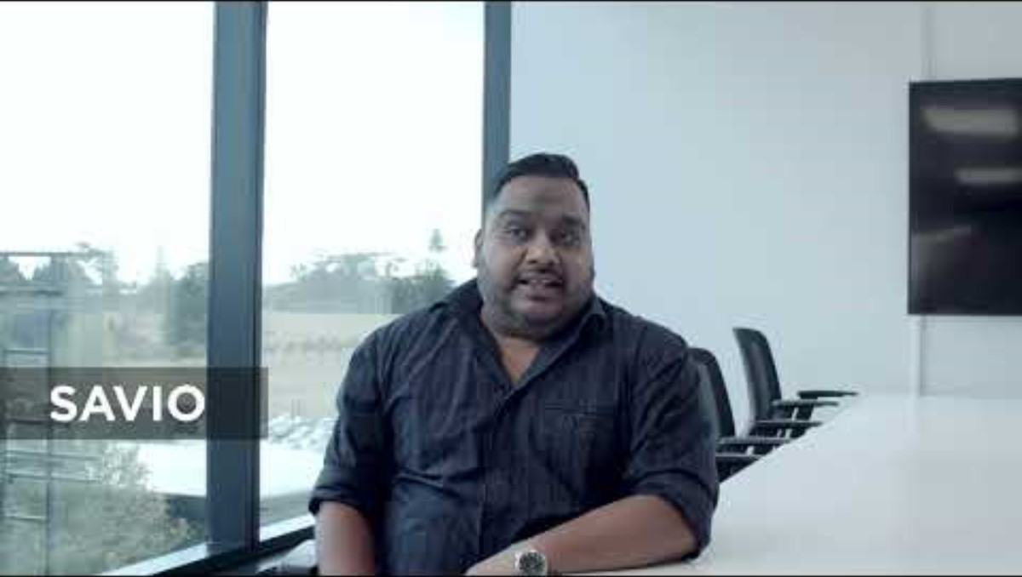

Slide 14




How can you speak up?
  It is important to have a workplace where speaking up is valued and encouraged.
Set aside time every day to discuss health and safety
Check in with each other about what could make your work safer safer
Make sure everyone has a chance to speak-up and influence how you are working
Keep each other informed about health and safety decisions
Speaking up can be hard. But try different things to encourage it.

Slide 15

SPEAK UP
Speak up – defining the culture we want.
  worksafe.govt.nz/strongculture

Slide 16

STEP UP

Slide 17
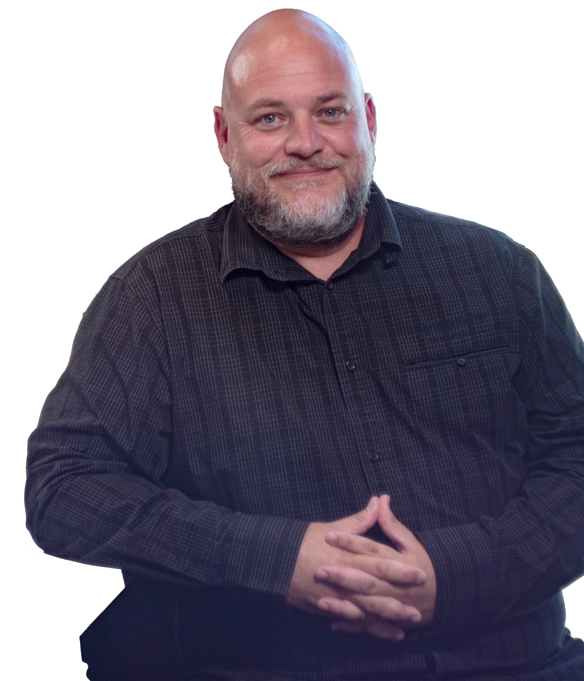
STEP UP
Do your bit to improve health and safety at work:
  Take part in health and safety training
  Do your work in a way that helps keep you and your mates safe
  Encourage your mates to follow good health and safety practices
  Get involved in decisions
  Look after people's wellbeing.

Slide 18
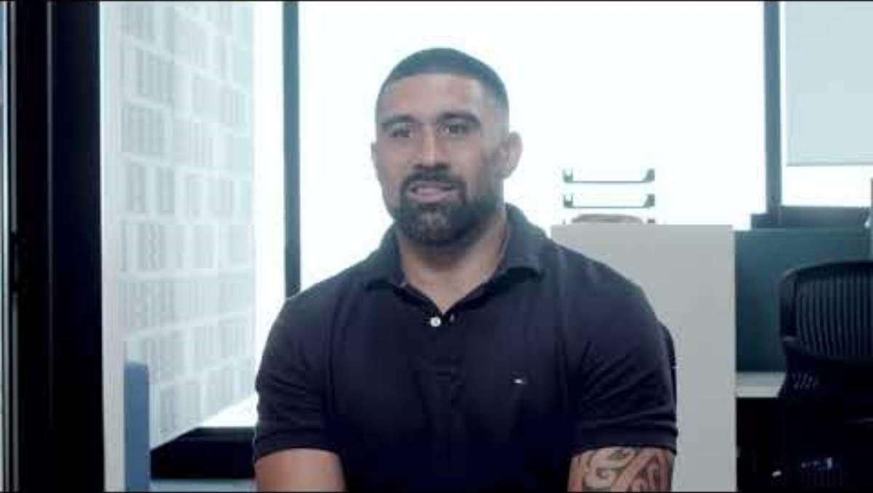

Slide 19

How can you step up?
  Things work best when you have a mix of formal and informal ways for people to step up.
Contribute to health and safety chats, risk registers and incident logs
Look out for each others’ wellbeing
and safety
Elect Health and Safety Representatives
Try different ways of stepping-up and figure out what helps the most.

Slide 20

STEP UP
Step up - working together to understand challenges and find solutions.
  worksafe.govt.nz/strongculture

Slide 21

Be the go-to health and safety person.

Slide 22
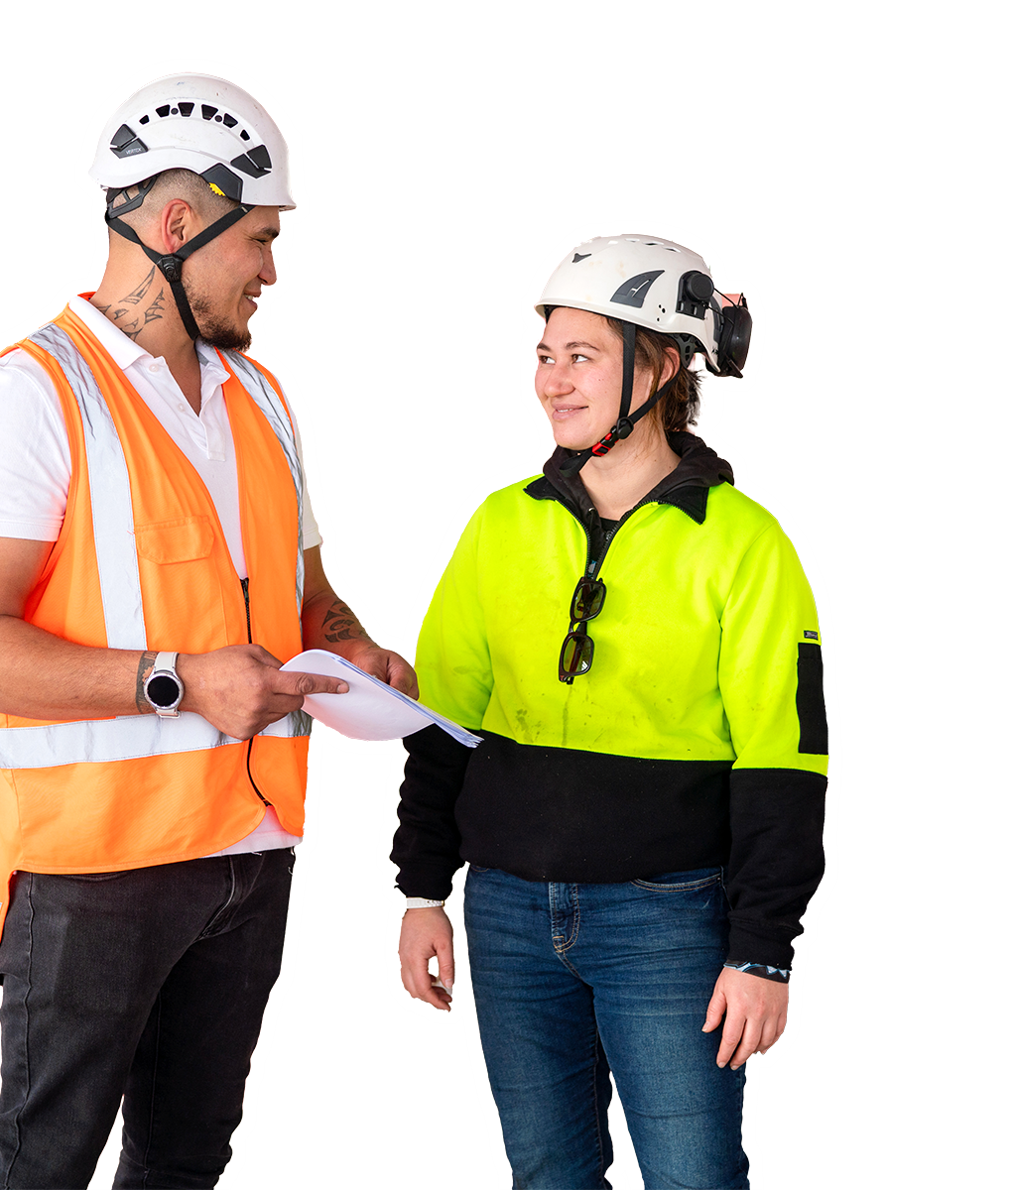
Be the go-to health and safety person
    Every workplace should have at least one go-to health and safety person, called a Health and Safety Representative (HSR)
    HSRs represent their workmates, making sure their voices are being heard in day-to-day work
    It's not a separate job – HSRs are everyday people
    The best HSRs are people who want to support their mates and keep them healthy and safe.

Slide 23


Slide 24



Be the go-to health and safety person
  An HSR’s role changes depending where they work, and who they are.
Businesses with HSRs are found to be healthier and safer
HSRs have legal power to make sure work is healthy and safe
HSRs influence how work is done
Reckon this sounds like you? Find out more about being an HSR on the WorkSafe website.

Slide 25
Build a strong health and safety culture.

Slide 26
Do your bit to make things safer
  Health and safety culture is about the shared beliefs, values, and attitudes of a workplace.
  A strong culture is built when everyone works together.
“Safety starts at the top. When workers see leaders taking health and safety seriously, it helps everyone do the same.”
“Everyone can show leadership and make a difference – including you and your mates.”
As a group, talk about what you can do to make a difference.

Slide 27

Take notice
  Are these things happening at work? What can you do to improve your health and safety culture?
Workers and managers are talking to each other about health and safety
Risks are being identified by everyone
People are comfortable speaking up and stepping up
There are go-to health and safety people or groups
Hazards are escalated and resolved quickly
Wellbeing is a focus at work

Slide 28

Keep going
Health and safety isn't just a box to tick – it's about always learning, and always improving.
You can keep health and safety front and centre by having:
Health and safety training
Health and safety registers and monitoring
Processes for identifying hazards and risks – and putting controls in place
Ways to acknowledge improvement
Electing go-to Health and Safety Representatives
Wellbeing time - to encourage better health

Slide 29
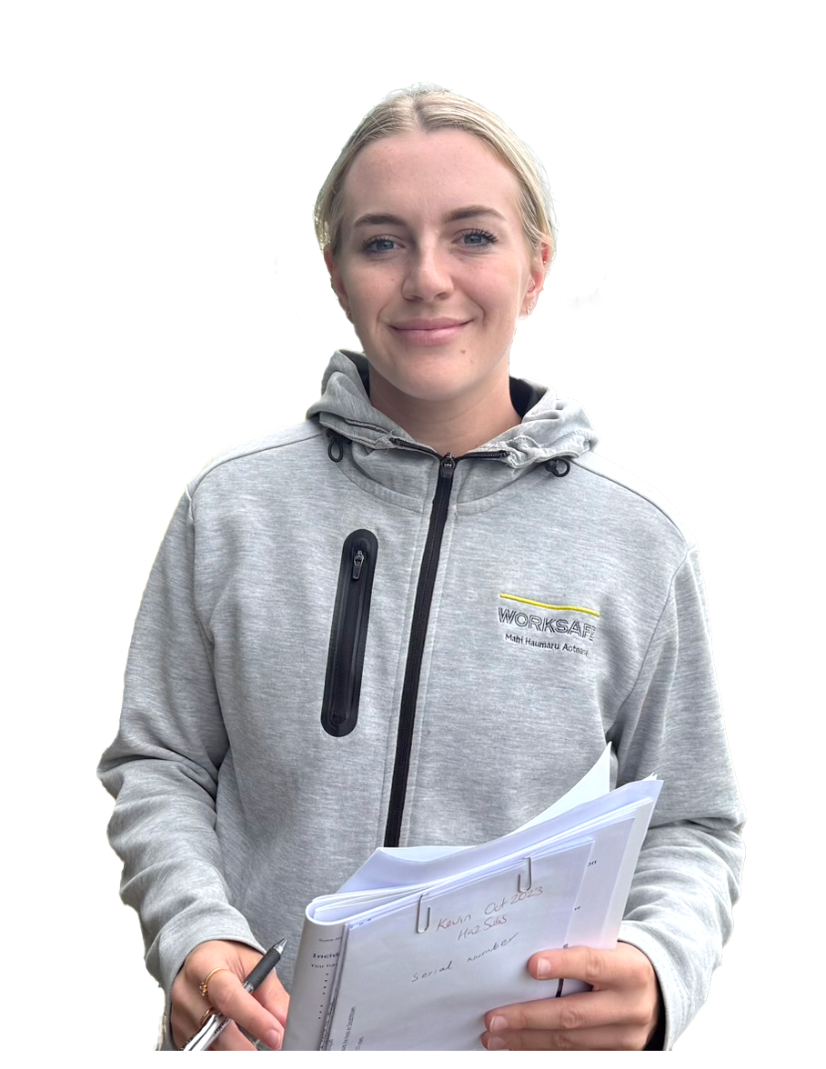
How can WorkSafe help?
There's lots of information and services available to help you to improve health and safety at your work:
Build a strong health and safety culture webpage
SafePlus self-assessment
Guidance for business owners
Puataunofo ‘Come Home Safely’
Requesting a site inspection or to talk to a member of our team
Visit www.worksafe.govt.nz

